Slide 1

QuickPC
Anthony Dawson
Gustavo Cisneros
Osman Khan
Jose Vasquez
Kevin Vu
Team: PC Gang
CECS 491A Spring 2020

Slide 2
Outline
What is QuickPC?
Motivation
Contribution
Impact
Stakeholder Model
Goal Model
System Vision
Usage Model
Main Features
Functional Requirements
Quality Requirements
Constraints
Development Process

Slide 3
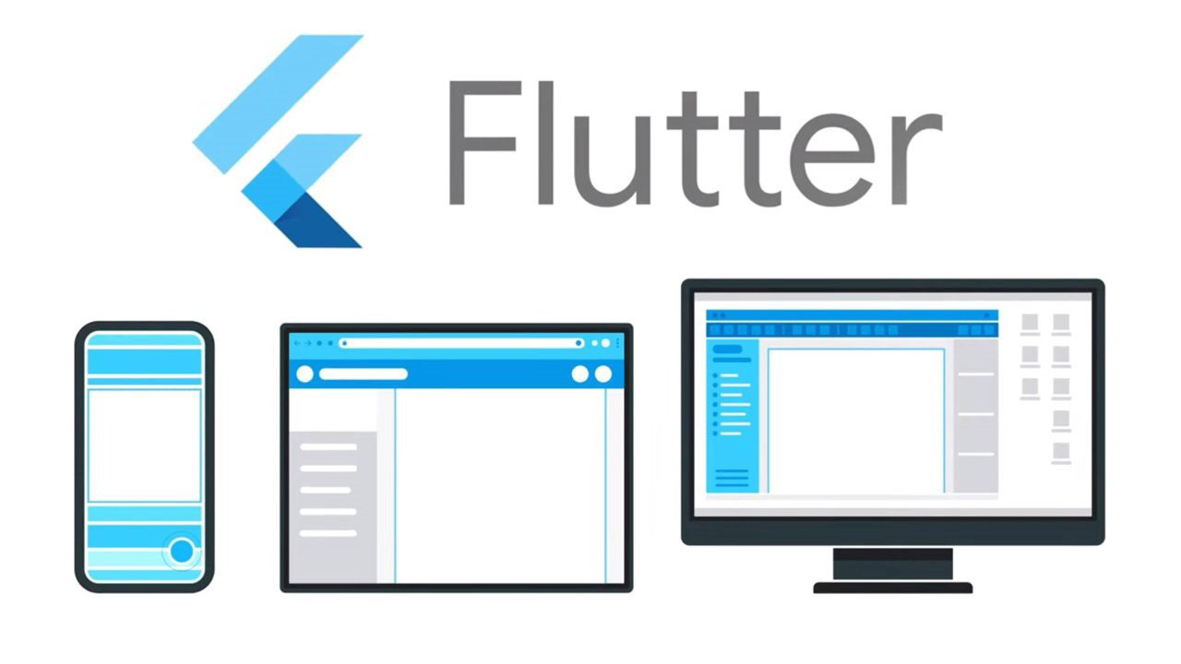
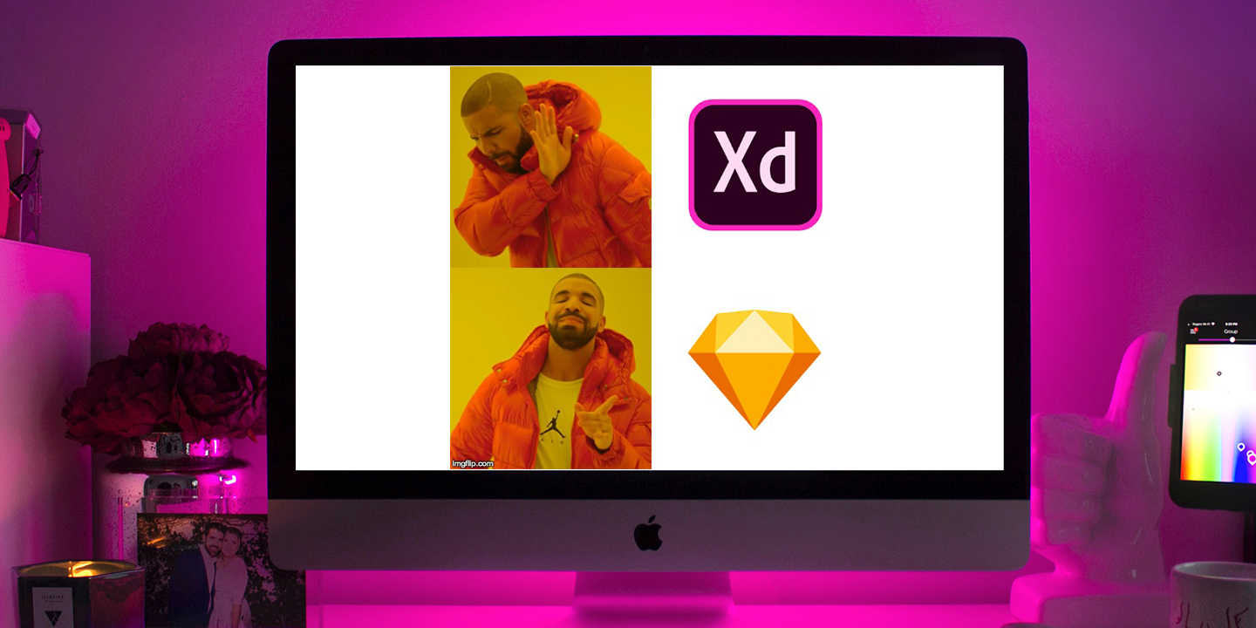

What is QuickPC?
Quick PC is a mobile application written in Dart using Flutter.
The application is designed to help users compare prices and compatibility of PC components.
Our app can recommend parts based on the user’s budget and consider what they want to use the PC for.
The app can also compare prices from different retailers to find the best deal for users looking for parts.

Slide 4

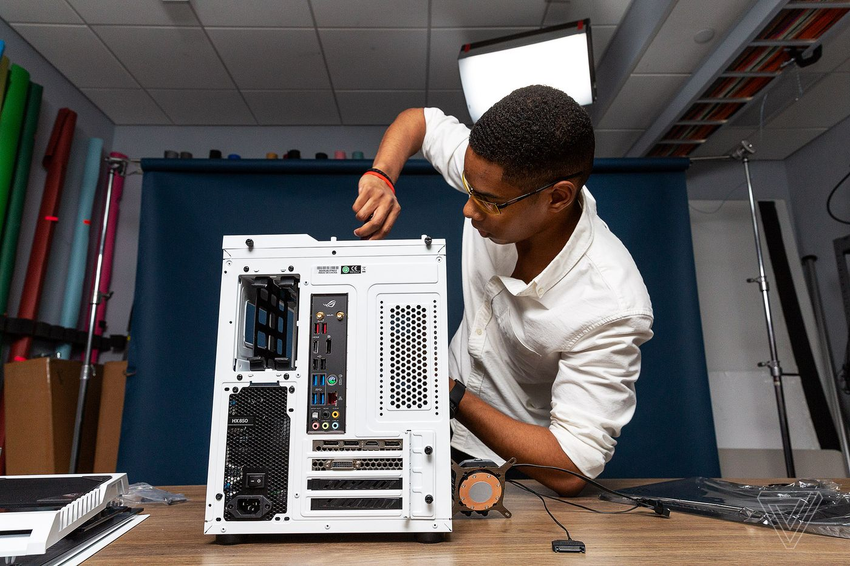
Motivation
Due to the COVID-19 pandemic, many people have gained interests in building a computer from scratch.
Our mobile application intends to assist people in learning the different types of PC components and their respective prices.
No such applications are widely available for mobile devices at the moment and the best version of this type of software is typically in the form of a mobile website which is unintuitive to use.

Slide 5
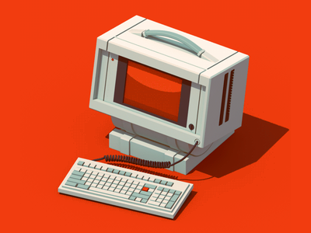
Contribution
Quick PC will start up asking the user to login to their already registered account or register for a newly made account.
Once a user has signed into their account they will arrive at the home screen.
This screen features a guide on how to assemble a PC, a page on what each part of a PC does, performance comparison on certain parts, a search bar for looking up parts, a system builder, and the ability to browse by parts.

Slide 6
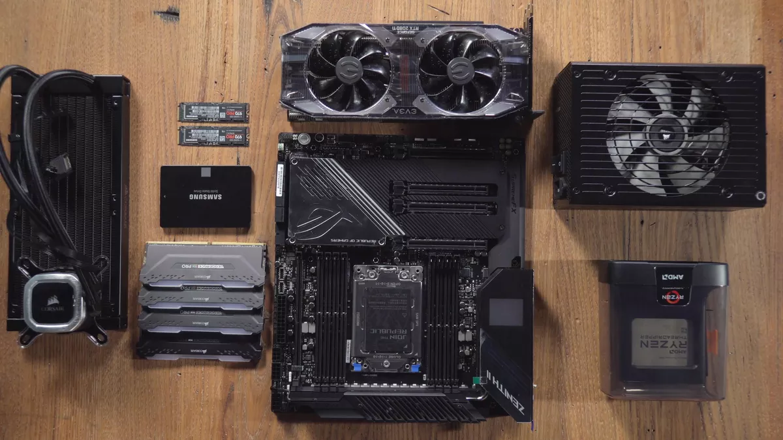
Impact
The purpose of Quick PC is to give users an accessible and informative way to build and assemble a computer that fits their needs.
The app can act as a gateway to learning about PC components and understanding the functions of each part.

Slide 7
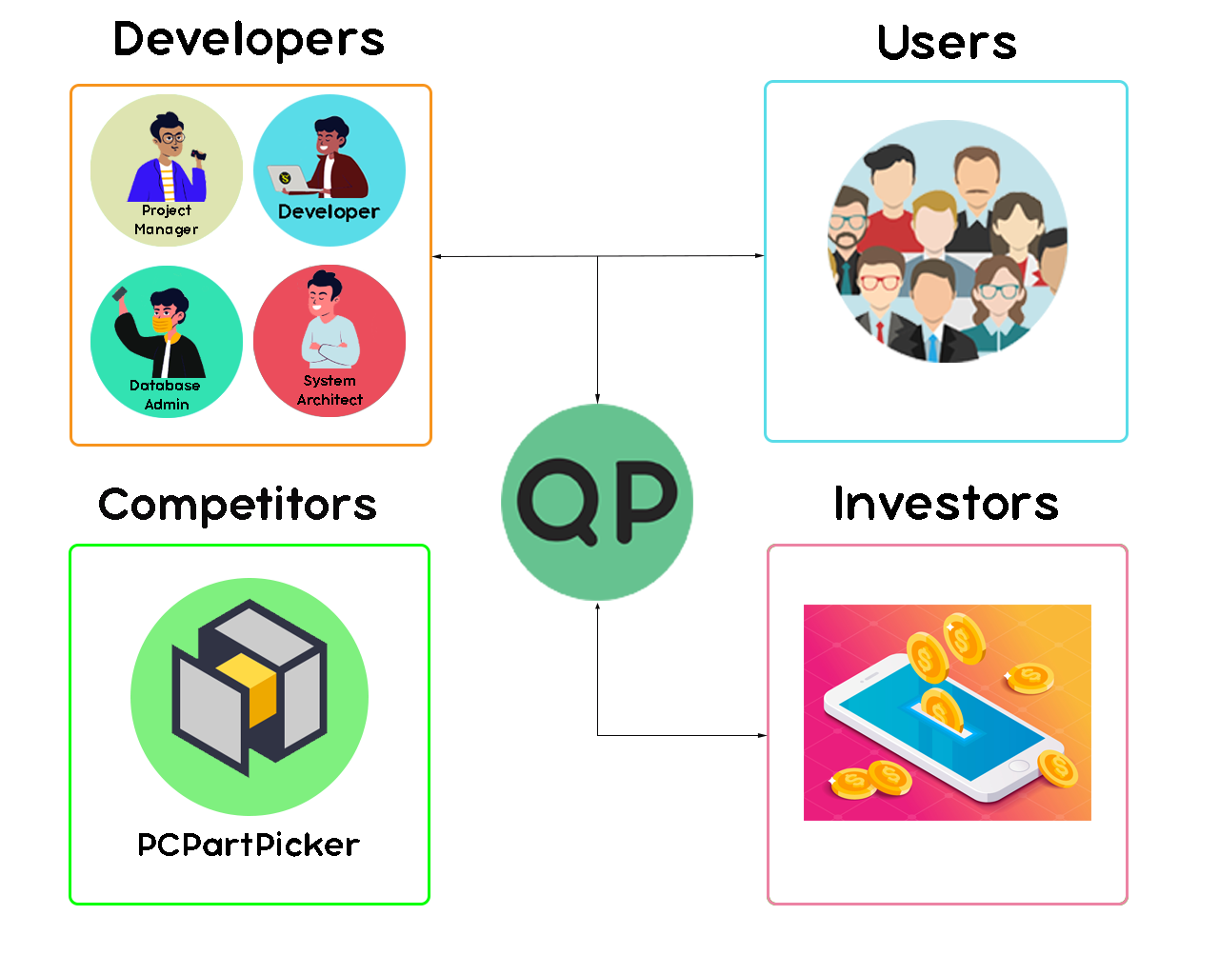
Stakeholder Model
The stakeholder model is a visual representation of all our stakeholders such as the developers, users, and investors.
One of our competitor is PCPartPicker which focuses on PC parts specification rather than focusing on guiding new users to PC building

Slide 8
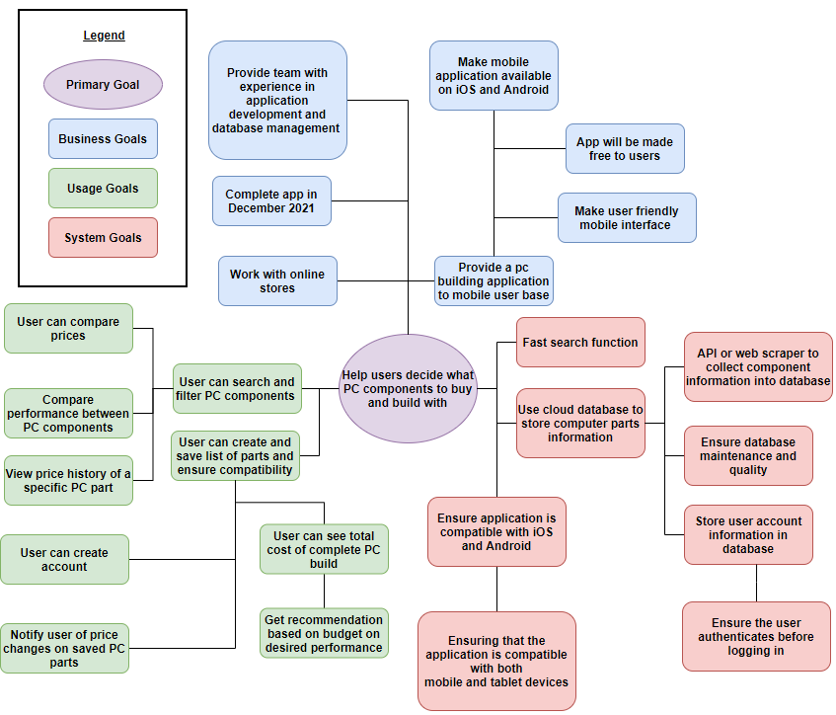
Goal Model
The goal model is a visual representation of all our goals we plan on accomplishing during the development of our application
Consists of:
Primary Goals
Business Goals
Usage Goals
System Goals

Slide 9
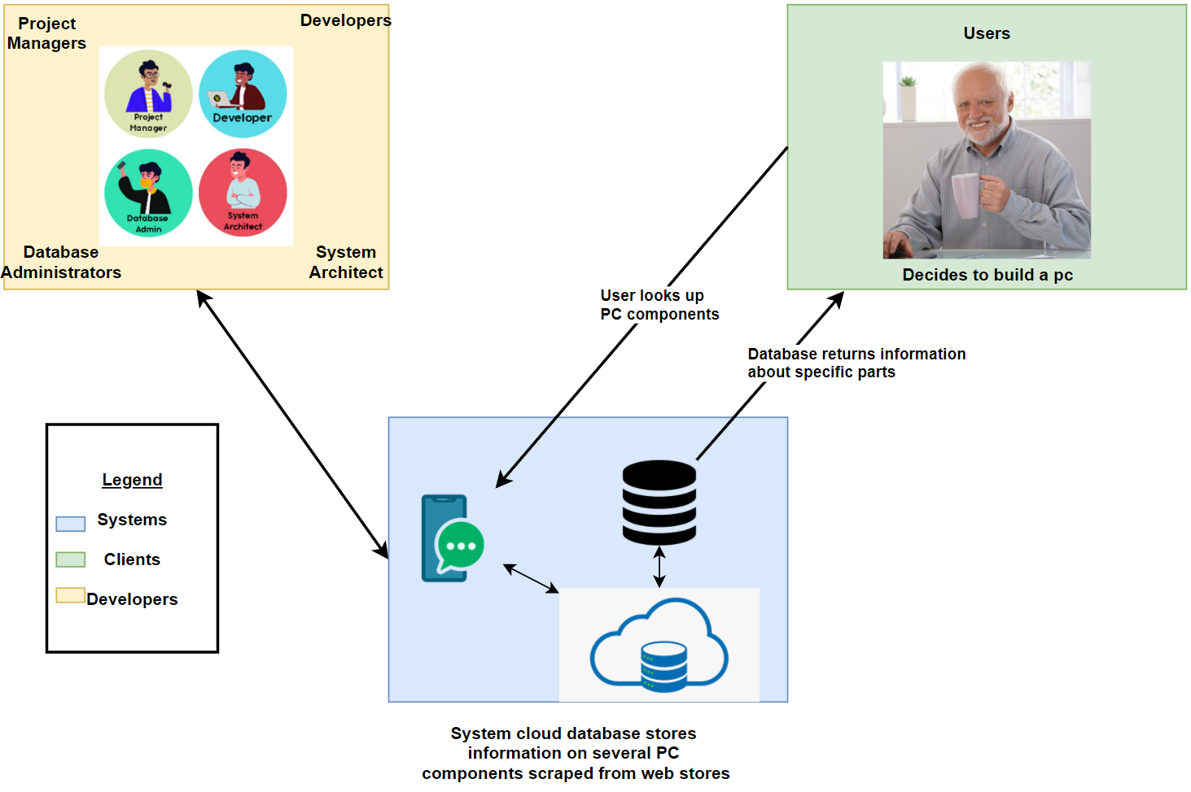
System Vision
Users
Searches parts, forms PC lists, and gives reviews to different parts
Developers
Designing, developing, and keeping the system updated.
System
Scrape online retailers for PC part info and store it in a database.

Slide 10
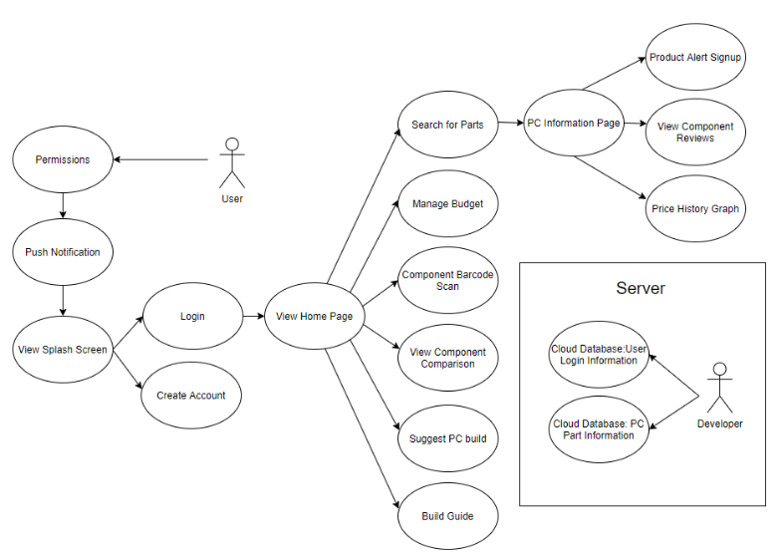
Usage Model

Slide 11
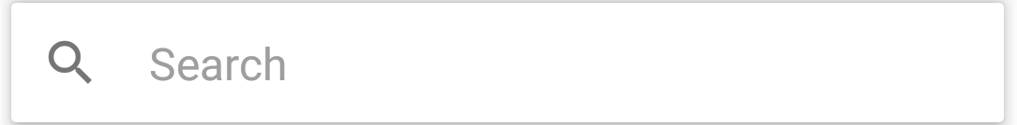


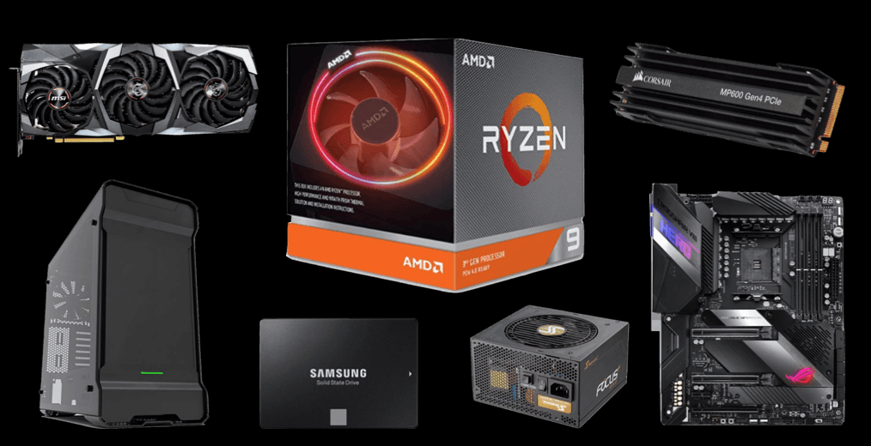
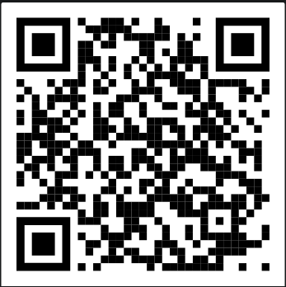
Main Features
Search for computer parts with prices, features, etc
Compare PC Parts
Manage budget for list of parts
Component Barcode Scan
Suggest PC build based on budget or desired performance
PC Build Guides
Mobile Friendly

Slide 12
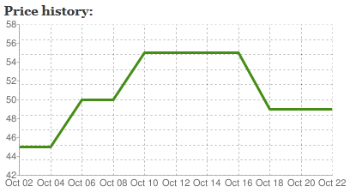

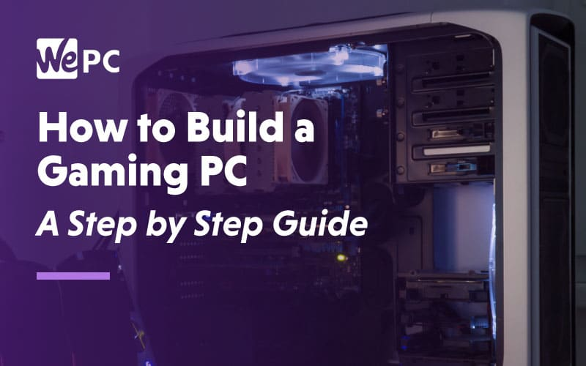
Functional Requirements
Database storage (Firebase)
Databases storing account information and user part list
Search engine system for hardware parts
User is able to filter parts by price, brand, new parts, most viewed
Price history graphs
Display a graph to the user with the price of certain part over a time frame
Build suggestion
Users are able to set a price range for their build and the system will recommend computer builds
Users are also able to specify if they are using the PC for gaming or work
Part ordering system
Users are able to sort by name, date released, most viewed, most recommended, etc

Slide 13
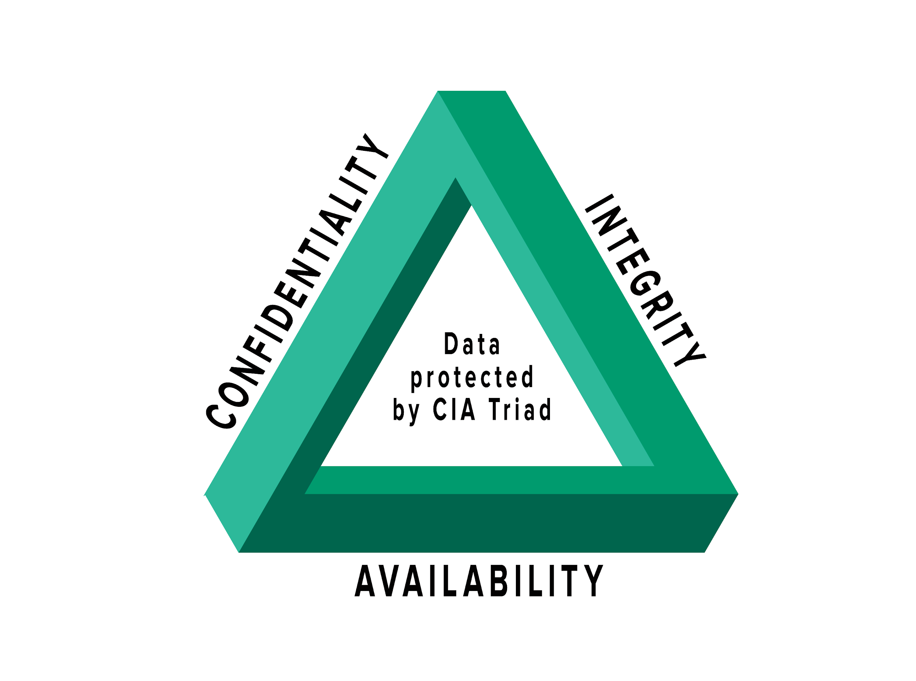
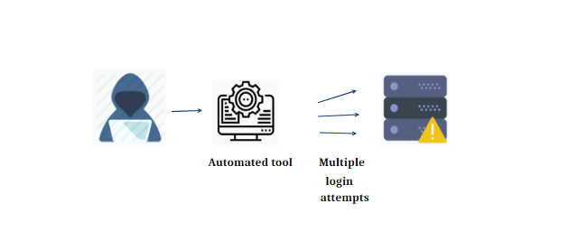
Quality Requirements
User friendly
Ensure the application functions are easily accessible
Efficient code - ensuring the program runs efficiently and effectively
Ensure the price tracking functions is up to date
Application is secure
Ensure customer’s account information is encrypted
Ensure that the database is secure against SQL injection, brute-force, and privilege escalation
Maintain the CIA triad
Make sure that data is private and well maintained
Ensures data has not been tampered with
Ensure the application is attack proof from denial-of-service-attack
Ensure that the application is available at all times
Notes:
yes

Slide 14
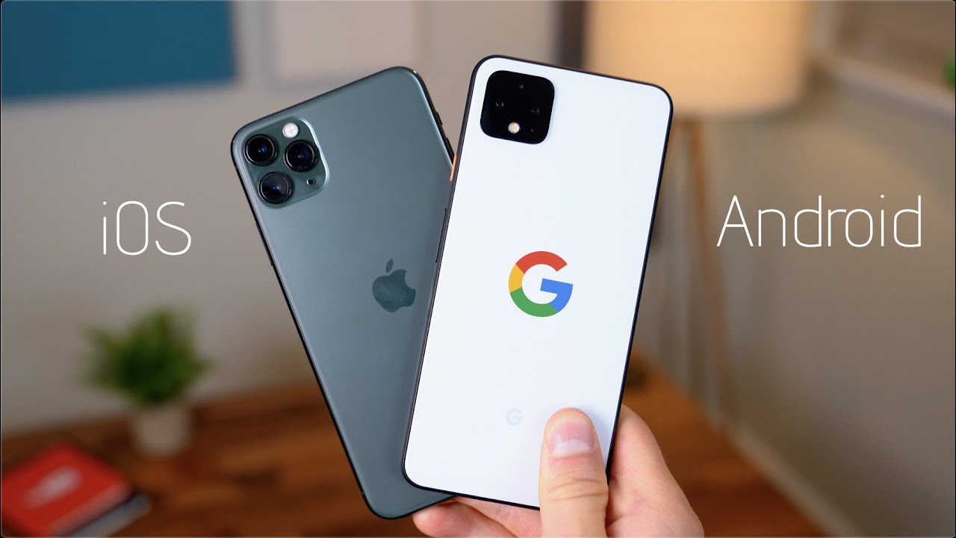
Constraints
Ensure that the project has enough funding for servers, databases, etc.
Mobile friendly (iOS, Android)
Ensure the application is fully functional
UI is designed using Adobe XD
Application is written in Dart using Flutter
Cloud Database (FireBase) is used to store customer information safely and efficiently
Data security/integrity is important

Slide 15

Development Process
Complete documentation for the application
Set up Google Firebase / SQLite to store customer information
Become familiar with Flutter and Adobe XD
Design UI through Adobe XD
Develop the mobile application through Flutter using Dart
Unit testing - testing feature functionality, bug fixing, etc.
Deploy the application once all application features are fully developed
Application maintenance - making sure the application, parts recommendation, and prices are up to date, adding QoL improvements if necessary

Slide 16
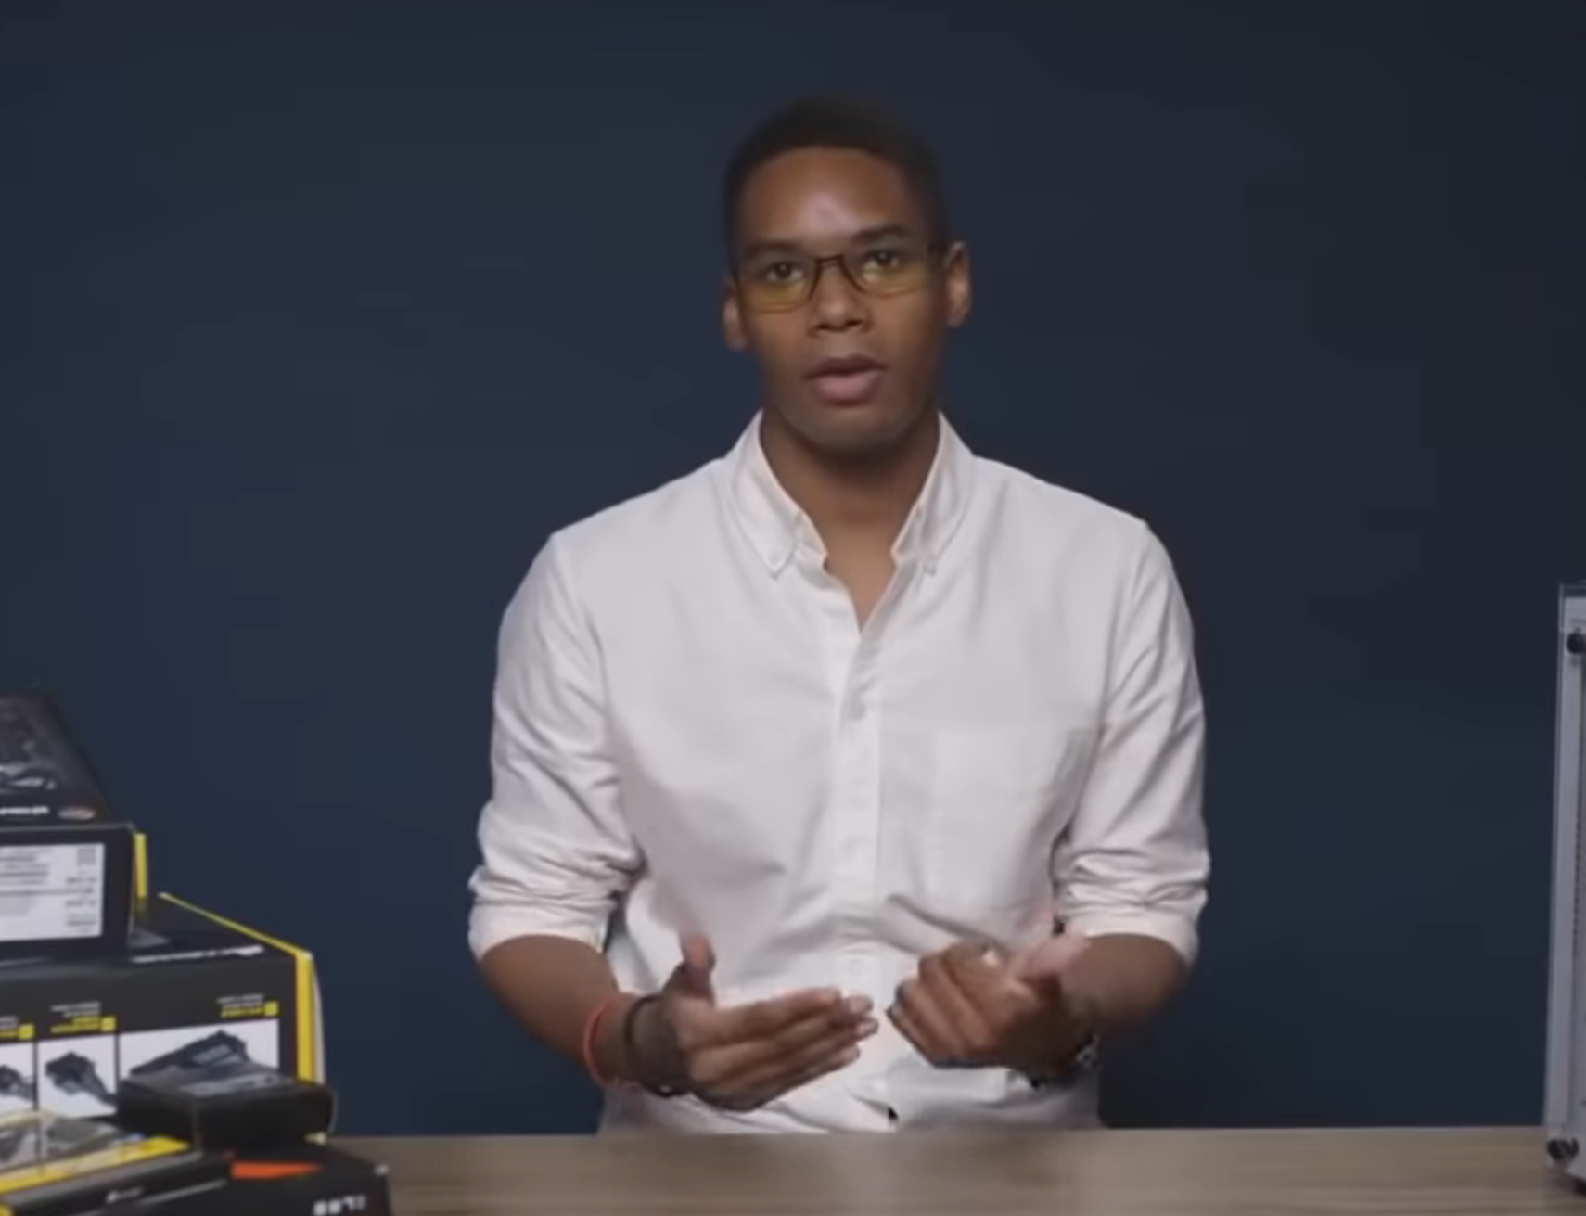
Any questions?

